Slide 1

Zillow Home Price Prediction
Navigating the Housing Market Landscape: Predicting Insights for Housing Owners
Harini Padmaja Solleti
Jaswanth Budigi
Likitha Sree Yarabarla
Nanaji Chalamalashetty
Notes:
Zillow Home Price Prediction

Slide 2
Introduction
Predict House Prices:
Utilize regression and decision tree models.
Achieve accurate predictions through robust modeling.
Identify Key Features:
Focus on essential attributes influencing house prices.
Enhance interpretability and efficiency through feature selection.
Quality Assessment with OverallQual:
Leverage machine learning for classification.
Categorize properties based on quality assessment.

Slide 3
AREAS OF FOCUS:
Enhance Property Appeal
Improve Market Visibility and Reach
Leverage Zestimate and Data-Driven Insights

Slide 4
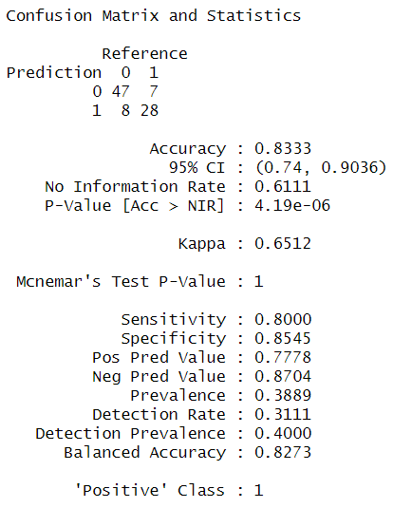
Feature Selection Methods:
Correlation Analysis:
finds the best attributes with the strongest correlations.
The following are important features: Total RMS AbvGrd, Full Bath, Year Built, Year Modified Add, Garage Area, and Sale Price.
Linear Regression:
Outstanding results on the training set. A test set with overfitting was noted.
Decision Tree:
Outstanding performance with possible overfitting.

Slide 5
Insights and Conclusions
Evaluation of regression models:
decision trees, and linear regression.
Notable performances and potential overfitting observed.
Classification models:
Logistic Regression, Decision Tree Classifier
Areas for further improvement and model tuning.

Slide 6
CONCLUSION:
In summary, the project contributes to the field of real estate analytics by providing a refined modeling strategy, insights into influential features, and a comprehensive understanding of the quality assessment process. These contributions are valuable for stakeholders in the real estate industry, data scientists, and researchers aiming to enhance predictive modeling techniques in housing markets.

Slide 7
Thank You

